Slide 1
Object Oriented Analysis and Design (OOA&D) Introduction to Software Engineering Introduction to Object Technology Introduction to UML

Slide 2
Objectives of this course
To introduce the concept of Software Engineering, Object Oriented (OO) Modeling, and Unified Modeling Language
To recognize and understand the basic concepts and constructs of OO modeling
To define the UML and its various types of diagrams
Understand the practical aspects of UML diagrams in the OO analysis and OO design stages of Software Engineering.
To go through basic and advanced properties of OO programming, including OO principles, advanced associations and relationships among programing constructs, O/R mapping

Slide 3
Outline
Software Development Life Cycle (SDLC)
Overview of Software Engineering
Overview of OOA&D
What is UML and why we use UML?
How to use UML diagrams to design software system?
What UML Modeling tools we use today?

Slide 4
Software Development Life Cycle (SDLC)
A systematic process for planning, creating, testing, deploying, and maintaining information systems and software applications.
The SDLC aims to produce high-quality software that meets or exceeds customer expectations, is delivered on time and within budget, and is easy to maintain and update.
The SDLC is a framework that guides the development process from the initial concept to the final implementation.

Slide 5
Software Development Life Cycle (SDLC) Phases
Software Development Life Cycle (SDLC) Phases
Planning/Feasibility study
Requirements Engineering
Analysis
Design
Coding
Testing
Implementation
Evolution (Support and Maintenance)

Slide 6
1. Planning:
Objectives: Define the project scope, objectives, and constraints. Identify stakeholders, create a project plan, and allocate resources.
Activities:
Feasibility study: Assess the technical, operational, and economic feasibility of the project.
Define project goals and requirements.
Develop a project schedule and allocate resources.
Create a risk management plan.

Slide 7
2. Requirements Analysis:
Objectives: Gather detailed requirements from stakeholders, including users and system specifications.
Activities:
Conduct interviews, surveys, and workshops to gather user requirements.
Analyze and document functional and non-functional requirements.
Create use cases, system specifications, and requirement specifications.

Slide 8
3. Design:
Objectives: Create a detailed design of the software based on the gathered requirements. Define the architecture, system components, interfaces, and data structures.
Activities:
System architecture design: Define the overall system structure.
Detailed design: Specify data structures, algorithms, and interface details.
Create design documents, such as architecture diagrams and system flowcharts.

Slide 9
4. Implementation (Coding):
Objectives: Translate the design into actual code. Write and test the source code to implement the specified functionality.
Activities:
Write and test individual modules or components.
Integrate components to build the complete system.
Conduct unit testing to verify the correctness of individual units.

Slide 10
5. Testing:
Objectives: Verify that the software functions as intended and identify and fix any defects.
Activities:
Conduct various levels of testing, including unit testing, integration testing, system testing, and acceptance testing.
Identify and fix defects.
Perform regression testing to ensure that new changes do not introduce new issues.

Slide 11
6. Deployment (Implementation):
Objectives: Release the software to the production environment and make it available to end-users.
Activities:
Create deployment plans and procedures.
Install and configure the software in the production environment.
Train end-users and support teams.
Monitor and troubleshoot the deployment process.

Slide 12
7. Maintenance and Support:
Objectives: Ensure that the software continues to meet user needs by addressing issues, making enhancements, and adapting to changes in the environment.
Activities:
Monitor system performance and user feedback.
Address defects and issues through maintenance releases.
Make enhancements and updates based on changing requirements.

Slide 13
Software Engineering (SE)

Slide 14
What is Software Engineering
Software engineering is the application of scientific principles to the design and creation of software.
The field uses a systematic approach to collect and analyze business requirements in order to design, build, and test software applications to satisfy those business requirements.

Slide 15
What is Software Engineering
“All aspects of Software Production”
SE is not only just concerned with the technical processes of software development but also with activities such as software project management and with the development of tools, methods and theories to support software production.

Slide 16
A brief history of Software Engineering (SE)
Before SE
The software engineering field became a discipline in the 1960s and evolved as new technologies were developed and the approach to software development became more scientific.
Initially, the creation of software lacked a formal development process. Which resulted in “software crises” from mid-1960s to mid-1980s. This was due to budget and schedule over runs, unmanageable, buggy code.
Often software development solutions that worked for small software systems did not scale to large, complex projects.
As the world widely adopted computers, software became increasingly integral to more aspects of life. The inefficiencies in the software development process made it difficult to meet the rapidly increasing demand for computing resources and complex software.

Slide 17
After SE
Trends in software engineering transformed from ad hoc programming towards more formal and standardized methods.
The mid 1980s also saw a rise in the growth of computer-aided software engineering or CASE which also helped to relieve the software crisis.
CASE tools can be divided into six categories: business analysis and modeling, development tools such as debugging environments, verification and validation tools, configuration management, metrics and measurement, and project management.

Slide 18
Who is a Software Engineer?
The term “software engineer” is often used interchangeably with software developer
but there are subtle differences.
Software engineers are also developers, but the term “software developer” is usually
deemed narrower in scope than that of a software engineer.
A software engineer’s knowledge is usually broader. Software engineers take a systematic, big picture approach in their thinking to software development whereas developers may have more creative approaches.
Both software engineers and software developers have specialized knowledge, but software engineers use that knowledge to build entire systems whereas software developers use their knowledge to write code to implement specific functionality within a system.

Slide 19
Who is a Software Engineer?
Software engineers are often employed on larger scale projects and they are focused on the broad structure rather than solving an immediate problem.
Software engineers are tasked with designing, building, and maintaining software systems.
Responsibilities include writing and testing code, and consulting with stakeholders such as clients, third party software vendors, security specialists, and other team members.

Slide 20
Object Oriented Modeling (OOM)

Slide 21
System modelling
System modelling helps the analyst to understand the functionality of the system and models are used to communicate with customers.
Different models present the system from different perspectives
Structural perspective showing the system or data architecture;
Behavioural perspective showing the behaviour of the system;
External perspective showing the system’s context or environment.

Slide 22
What is Object Oriented Technology
Object-oriented technology (OOT) is a term used to refer to the collection
of technologies, languages, frameworks, and other tools that we can use
when engaging in object-oriented programming.
Emphasis of OOT is on the objects and their behavior, and not on processes and
data.
In object-oriented programming we are focused on things called objects; those are the how we solve our solutions. In object-oriented programming, we design programming elements that model or reflect the real world elements about which we are trying to program. Angular, the Spring Ecosystem, Jakarta EE (previously Java EE), are some commonly used OO frameworks. Simula nd Smaltalk and amongst the very first
OO programming languages developed in 90s. The SW industry is working
with Java, Python, C# to develop most OO programs.

Slide 23
Object Oriented Modeling: Three Models
Object Model – describes the static structure of objects in the system and their relationships.
Dynamic Model – describes the aspect of the system that change over time, i.e. interaction among objects.
Functional Model – describes data value transformation in the system.

Slide 24
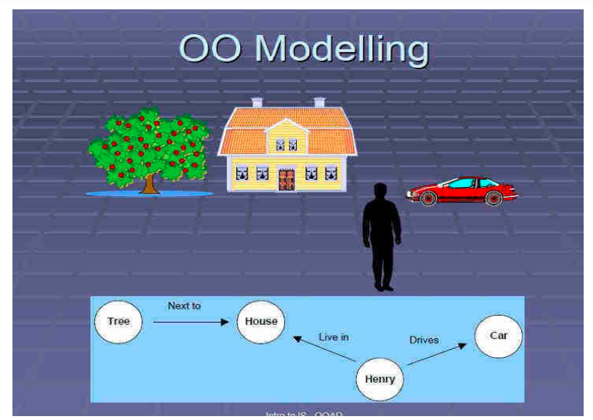

Slide 25
Object Modeling
Object-oriented analysis (OOA)
OOA is the process of analyzing a problem domain to identify the objects (entities), their attributes, and the relationships between them.
It involves studying the requirements of a system and modeling them in terms of objects, classes, and their interactions.
During this phase, analysts work on understanding the problem, defining the system's requirements, and identifying the main entities and their characteristics.
Object modeling
a technique for identifying objects within the systems environment and the relationships between those objects.

Slide 26
Object Model
Describes the structure of objects in a system-
- Identity
- Relationship to other objects
- Their attributes
- And their operations.
Example:
If you were designing a system for a library, the object model might include classes such as "Book," "Author," and "LibraryMember." Each class would have attributes (e.g., book title, author name) and methods (e.g., check-out, return) that define their behavior and interactions.

Slide 27
Dynamic Model
The dynamic model in OOAD focuses on the dynamic behavior of a system by capturing the interactions and collaborations among objects over time.
It includes state transitions, events, and the flow of control between objects during the execution of a system. OR
Describes those aspects of the system concerned with time and sequencing of operations-
Events that make change
Sequence of events
States that define context of events
And organization of events and states.

Slide 28
Dynamic Model
Example:
Continuing with the library system example, the dynamic model could represent the process of a library member checking out a book.
It would involve interactions between objects like the "LibraryMember" and "Book," with methods like "checkOut()" being called, leading to changes in the state of the objects.

Slide 29
Functional Model
Describes those aspects of the system concerned with transformation of values-
Functions
Mappings
Constraints
Functional dependencies
Is represented with Data Flow Diagrams.
Notes:
Functional dependencies are a concept in database management that describes the relationship between attributes in a relation (table). In a relational database, a relation consists of attributes (columns), and functional dependencies express the dependency of one attribute on another within that relation.

Slide 30
Functional Model Con…
The functional model focuses on what the system does, the functionalities it provides, and how it responds to inputs.
It is concerned with the logical processing and transformation of data within the system.
In the context of software design, the functional model describes the functions, processes, and operations that the software system must perform.
It often involves creating diagrams, such as use case diagrams, functional flowcharts, and entity-relationship diagrams, to illustrate the relationships between different components and the flow of data or control between them.

Slide 31
Object-oriented analysis and design
– An Overview
• Object-oriented analysis and design (OOAD) is a popular technical approach for
• Analyzing,
• Designing an application, system, or business
• By applying the object oriented paradigm and
• Visual modeling throughout the development life cycles for better communication and product quality.

Slide 32
Object-oriented analysis and design
• Object-oriented programming (OOP) is a method
• based on the concept of “objects",
• which are data structures that contain data,
• in the form of fields,
• often known as attributes;
• and code, in the form of procedures,
• often known as methods.

Slide 33
Object-oriented programming (OOP) Con…
OOP is the actual implementation of the design using an object-oriented programming language like Java, C++, or Python.
In OOP, classes and objects are used to structure the code, encapsulating data and behavior within objects and allowing for code reuse through concepts like inheritance and polymorphism.
Notes:
Encapsulation: Bundling data and methods that operate on the data into a single unit (class).
Inheritance: Allowing a class to inherit properties and behaviors from another class, promoting code reuse and extending functionality.
Polymorphism: Allowing objects of different types to be treated as objects of a common type, simplifying code and making it more flexible.

Slide 34
What is OOAD?-
Object-oriented analysis and design (OOAD) is a software engineering approach that models a system as a group of interacting objects .
• Analysis — understanding, finding and describing concepts in the problem domain.
• Design — understanding and defining software solution/objects that represent the analysis concepts and will eventually be implemented in code.
• OOAD - A software development approach that emphasizes a logical solution based on objects.

Slide 35
Software development is dynamic and always undergoing major change.
System development refers to all activities that go into producing information system solution.
System development activities consist of the folowing system analysis,
modelling,
design,
implementation,
testing and maintenance.
A software development methodology -- series of processes -- can lead to the development of an application.
Practices, procedures, and rules used to develop software, totally based on system requirements

Slide 36
ORTHOGONAL VIEWS OF THE SOFTWARE
Two Approaches,
Traditional Approach
Objected-Oriented Approach
TRADITIONAL APPROACH
• Collection of programs or functions.
• A system that is designed for performing certain actions.
• Algorithms + Data Structures = Programs.
• Software Development Models (Waterfall, Spiral, Incremental, etc..)

Slide 37
OBJECT ORIENTED APPROACH
• OO development offers a different model from the traditional software based on functions and procedures. • software is a collection of discrete object that encapsulate their data as well as the functionality.
• Each object has attributes (properties) and method (procedures).
• software by building self contained modules or objects that can be easily REPLACED, MODIFIED AND REUSED.
• Objects grouped in to classes and object are responsible for itself.

Slide 38
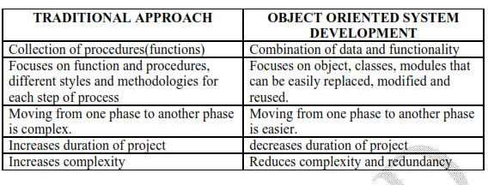
Difference between Traditional and Object Oriented Approach

Slide 39
BENEFITS OF OBJECT ORIENTATION
Faster development,
Reusability,
Increased quality
Modeling the real world and provides us with the stronger equivalence of the real world‘s entities(objects).
Raising the level of abstraction to the point where application can be implemented in the same terms as they are described.

